Slide 1
Week 1 Review: Induction
CS161 Winter 2026
Zoe Wefers
01-09-2026

Slide 2
Week 1 Review: Induction
CS161 Winter 2026
Zoe Wefers
01-09-2026

Slide 3
What is Induction?
Induction is a powerful and elegant proof technique for specific type of mathematical statements (ones true for all positive integers)
Induction naturally builds on our intuition to “try out examples” when presented with a new problem

Slide 4
How to construct an inductive proof?
To prove a statement by induction do the following …
State your problem in the form: P_{n} for all positive integers n
Demonstrate that P_{n} holds for a small fixed n (usually n=0 or n=1) (aka “base case”)
Assume that P_{n} is true for an arbitrary positive integer n (aka “inductive hypothesis)
Show that P_{n} implies P_{n+1} by invoking the induction hypothesis (“aka inductive step)

Slide 5
Let’s try an example together!
Prove that every power of of 13 can be written as the sum of two squares

Slide 6
Claim: Every power of 13 can be written as the sum of two squares
Problem Statement: For all positive integers n, there exists integers x and y such that 13^{n} = x² + y²
Base Case (n=1): 13 = 4 + 9 = 2² + 3²
Induction Hypothesis: Let n be a natural number. Assume that 13^{n} = x² + y² for some integers x and y
13^{n+1} = 13 x 13^{n}
= (2² + 3²)13^{n}
= (2² + 3²)(a² + b²) for some integers a and b by the induction hypotheses
= 2²a² + 3²b² + 3²a² + 2²b²
= (2²a² + 12ab + 3²b²) + (3²a² - 12ab + 2²b²)
= (2a+3b)² + (3a - 2b)² and now let x = 2a + 3b and y = 3a - 2b which are both integers
= x² + y² → QED!

Slide 7
Claim: Every power of 13 can be written as the sum of two squares
Problem Statement: For all positive integers n, there exists integers x and y such that 13^{n} = x² + y²
Base Case (n=1): 13 = 4 + 9 = 2² + 3²
Induction Hypothesis: Let n be a natural number. Assume that 13^{n} = x² + y² for some integers x and y
13^{n+1} = 13 x 13^{n}
= (2² + 3²)13^{n}
= (2² + 3²)(a² + b²) for some integers a and b by the induction hypotheses
= 2²a² + 3²b² + 3²a² + 2²b²
= (2²a² + 12ab + 3²b²) + (3²a² - 12ab + 2²b²)
= (2a+3b)² + (3a - 2b)² and now let x = 2a + 3b and y = 3a - 2b which are both integers
= x² + y² → QED!

Slide 8
Claim: Every power of 13 can be written as the sum of two squares
Problem Statement: For all natural numbers n, there exists integers x and y such that 13^{n} = x² + y²
Base Case (n=1): 13 = 4 + 9 = 2² + 3²
Induction Hypothesis: Let n be a positive integers. Assume that 13^{n} = x² + y² for some integers x and y
13^{n+1} = 13 x 13^{n}
= (2² + 3²)13^{n}
= (2² + 3²)(a² + b²) for some integers a and b by the induction hypotheses
= 2²a² + 3²b² + 3²a² + 2²b²
= (2²a² + 12ab + 3²b²) + (3²a² - 12ab + 2²b²)
= (2a+3b)² + (3a - 2b)² and now let x = 2a + 3b and y = 3a - 2b which are both integers
= x² + y² → QED!

Slide 9
Claim: Every power of 13 can be written as the sum of two squares
Problem Statement: For all natural numbers n, there exists integers x and y such that 13^{n} = x² + y²
Base Case (n=1): 13 = 4 + 9 = 2² + 3²
Induction Hypothesis: Let n be a positive integers. Assume that 13^{n} = x² + y² for some integers x and y
13^{n+1} = 13 x 13^{n}
= (2² + 3²)13^{n}
= (2² + 3²)(a² + b²) for some integers a and b by the induction hypotheses
= 2²a² + 3²b² + 3²a² + 2²b²
= (2²a² + 12ab + 3²b²) + (3²a² - 12ab + 2²b²)
= (2a+3b)² + (3a - 2b)² and now let x = 2a + 3b and y = 3a - 2b which are both integers
= x² + y² → QED!

Slide 10
Why does induction work?
If you prove the base case, the inductive hypothesis and the inductive proof can be iteratively applied to prove that the claim hold for all positive integers
Base Case = P₀ → P₁ → P₂ → P₃ → …. P_{n} → P_{n+1} → …
And inductive proof is like an algorithm with a loop that proves the claim for each n

Slide 11
Why does induction work?
Say we proved the base case for P₀
Assume for sake of contradiction that claim P_{n} does not hold for some positive integer n.
Let n* be the smallest positive integer for such that P_{n*} does not hold. Then P_{n*-1} must hold.
But by the inductive step P_{n*-1} implies P_{n*}. Thus we have found a contradiction!

Slide 12
When does induction fail?
Claim: Everyone loves algorithms
Proof:
Problem Statement: For all positive integers n, any group of n people, all people in the group love algorithms
Base Case: Zoe loves algorithms!
Inductive Hypothesis: Assume that any group of n people love algorithms
Inductive Step: Say you have a group of n+1 people. Isolate the tallest n people in the group. By the IH they all love algorithms. Isolate the shortest n people. By the IH they all love algorithms. The union of these two subgroup contains all people in the group. Thus all people in the group love algorithms!
Where are the errors in this proof?

Slide 13
When does induction fail?
Claim: Everyone loves algorithms
Proof:
Problem Statement: For any group of n people, all people in the group love algorithms
Base Case: Zoe loves algorithms!
Inductive Hypothesis: Assume that any group of n people love algorithms
Inductive Step: Say you have a group of n+1 people. Isolate the tallest n people in the group. By the IH they all love algorithms. Isolate the shortest n people. By the IH they all love algorithms. Clearly, union of these two subgroup contains all people in the group. Thus all people in the group love algorithms!
Where are the errors in this proof?

Slide 14
When does induction fail?
Claim: Everyone loves algorithms
Proof:
Problem Statement: For any group of n people, all people in the group love algorithms
Base Case: Zoe loves algorithms! (Base case is not general! Should be for any group of 1)
Inductive Hypothesis: Assume that any group of n people love algorithms
Inductive Step: Say you have a group of n+1 people. Isolate the tallest n people in the group. By the IH they all love algorithms. Isolate the shortest n people. By the IH they all love algorithms. Clearly, union of these two subgroup contains all people in the group. Thus all people in the group love algorithms!
Where are the errors in this proof?

Slide 15
Let’s try another example!

Slide 16
When does induction fail?
Claim: Everyone has the same name
Proof:
Problem Statement: For any group of n people, all people in the group have the same name
Base Case: A single person has their own name
Inductive Hypothesis: Assume that for any group of n people, everyone in the group has the same name
Inductive Step: Say you have a group of n+1 people. Isolate the tallest n people in the group. By the IH they all have the same name. Isolate the shortest n people. By the IH they all have the same name. The second tallest person is in both groups. Thus everyone in each subgroup has the same name as the second tallest person. The union of the two subgroups contains the entire group. Thus everyone in the entire group has the same name (the name of the second tallest person).
Where are the errors in this proof?

Slide 17
When does induction fail?
Claim: Everyone has the same name
Proof:
Problem Statement: For any group of n people, all people in the group have the same name
Base Case: A single person has their own name
Inductive Hypothesis: Assume that for any group of n people, everyone in the group has the same name
Inductive Step: Say you have a group of n+1 people. Isolate the tallest n people in the group. By the IH they all have the same name. Isolate the shortest n people. By the IH they all have the same name. The second tallest person is in both groups. Thus everyone in each subgroup has the same name as the second tallest person. The union of the two subgroups contains the entire group. Thus everyone in the entire group has the same name (the name of the second tallest person).
Where are the errors in this proof?

Slide 18
When does induction fail?
Claim: Everyone has the same name
Proof:
Problem Statement: For any group of n people, all people in the group have the same name
Base Case: A single person has their own name
Inductive Hypothesis: Assume that for any group of n people, everyone in the group has the same name
Inductive Step: Say you have a group of n+1 people. Isolate the tallest n people in the group. By the IH they all have the same name. Isolate the shortest n people. By the IH they all have the same name. The second tallest person is in both groups. Thus everyone in each subgroup has the same name as the second tallest person. The union of the two subgroups contains the entire group. Thus everyone in the entire group has the same name (the name of the second tallest person).
IS implicitly assume that there are at least 3 people in the group. Base case is for n=1, but missing n=2. IS does not hold for n+1=2

Slide 19
More examples (increasing difficulty)
The sum of the n first odd numbers in n²
The sum of integers from 1 to n is n(n-1)/2
The number of nodes in a complete binary tree of height n is 2^{n}-1
2^{n+2} + 3^{2n+1} is divisible by 7 for all positive integers
All polygons can be “triangulated” with diagonals
Let finitely many lines divides a plane into regions. There is always a way to colors the regions with two colors in such a way that adjacent regions have different colors.

Slide 20
Solutions
4) Page 3 of https://math.dartmouth.edu/archive/m25f19/public_html/Documents/InductionPractice_solns.pdf
5) https://math.stackexchange.com/questions/1877253/triangulation-of-a-simple-polygon-elementary-proof
6) https://www.cut-the-knot.org/Curriculum/Geometry/TwoColorColoring.shtml

Slide 21
Weak Induction vs Strong Induction
Base Case: Show that P_{n} is true for small fixed n (usually n=0 or n=1)
IH: Assume that P_{n} is true for some positive integer n
IS: Prove that P_{n} implies P_{n+1}
Base Case: Show that P_{n} is true for small fixed n (usually n=0 or n=1)
IH: Show that P_{k} is true for all 0<k<n for some positive integer n
IS: Prove that the IH implies that P_{n+1} is also true

Slide 22
Weak vs Strong Induction
Strong Induction assume the statement is true at all steps from the base case to the n-th step
Weak induction only assumes that the statement is true at the n-th step
Weak and Strong Induction are logically equivalent, but sometimes it is simpler to prove something with strong induction

Slide 23
Let’s try an example of Strong Induction!
Prove that every integer can be written as a product of prime factors.

Slide 24
Claim: Every integer can be written as a product of prime factors
Problem Statement: For all natural numbers n>1, n=x₁ * x₂ * … * x_{k} where x_{i} is prime for all i
Base Case (n=2): 2 is a product of one prime (itself)
Induction Hypothesis: Let n be a positive integers. Assume that for all integers 2<k<=n, k can be written as a product of prime numbers
Case 1:
If n+1 is prime, then it can be written a product of one prime (itself)
Case 2:
If n+1 is not prime then it can be written as the product of two factors, a and b.
So n+1 = a*b and we know that 2<a,b<n. The IH applies to both a and b.
So a=x₁ * x₂ * … * x_{k} and b=y₁ * y₂ * … * y_{m} where x_{i} and y_{j} are prime for all i and j.
Then n+1 = x₁ * x₂ * … * x_{k}*x₁ * x₂ * … * x_{k} which is a product of primes. Thus the IH hold for n+1

Slide 25
Claim: Every integer can be written as a product of prime factors
Problem Statement: For all natural numbers n>1, n=x₁ * x₂ * … * x_{k} where x_{i} is prime for all i
Base Case (n=2): 2 is a product of one prime (itself)
Induction Hypothesis: Let n be a positive integers. Assume that for all integers 2<k<=n, k can be written as a product of prime numbers
Case 1:
If n+1 is prime, then it can be written a product of one prime (itself)
Case 2:
If n+1 is not prime then it can be written as the product of two factors, a and b.
So n+1 = a*b and we know that 2<a,b<n. The IH applies to both a and b.
So a=x₁ * x₂ * … * x_{k} and b=y₁ * y₂ * … * y_{m} where x_{i} and y_{j} are prime for all i and j.
Then n+1 = x₁ * x₂ * … * x_{k}*x₁ * x₂ * … * x_{k} which is a product of primes. Thus the IH hold for n+1

Slide 26
Claim: Every integer can be written as a product of prime factors
Problem Statement: For all natural numbers n>1, n=x₁ * x₂ * … * x_{k} where x_{i} is prime for all i
Base Case (n=2): 2 is a product of one prime (itself)
Induction Hypothesis: Let n be a positive integers. Assume that for all integers 2<k<=n, k can be written as a product of prime numbers
Case 1:
If n+1 is prime, then it can be written a product of one prime (itself)
Case 2:
If n+1 is not prime then it can be written as the product of two factors, a and b.
So n+1 = a*b and we know that 2<a,b<n. The IH applies to both a and b.
So a=x₁ * x₂ * … * x_{k} and b=y₁ * y₂ * … * y_{m} where x_{i} and y_{j} are prime for all i and j.
Then n+1 = x₁ * x₂ * … * x_{k}*x₁ * x₂ * … * x_{k} which is a product of primes. Thus the IH hold for n+1

Slide 27
Claim: Every integer can be written as a product of prime factors
Problem Statement: For all natural numbers n>1, n=x₁ * x₂ * … * x_{k} where x_{i} is prime for all i
Base Case (n=2): 2 is a product of one prime (itself)
Induction Hypothesis: Let n be a positive integers. Assume that for all integers 2<k<=n, k can be written as a product of prime numbers
Case 1:
If n+1 is prime thenthen it can be written a product of one prime (itself)
Case 2:
If n+1 is not prime then it can be written as the product of two factors, a and b.
So n+1 = a*b and we know that 2<a,b<n. The IH applies to both a and b.
So a=x₁ * x₂ * … * x_{k} and b=y₁ * y₂ * … * y_{m} where x_{i} and y_{j} are prime for all i and j.
Then n+1 = x₁ * x₂ * … * x_{k}*x₁ * x₂ * … * x_{k} which is a product of primes. Thus the IH hold for n+1

Slide 28
Claim: Every integer can be written as a product of prime factors
Problem Statement: For all natural numbers n>1, n=x₁ * x₂ * … * x_{k} where x_{i} is prime for all i
Base Case (n=2): 2 is a product of one prime (itself)
Induction Hypothesis: Let n be a positive integers. Assume that for all integers 2<k<=n, k can be written as a product of prime numbers
Case 1:
If n+1 is prime then it can be written a product of one prime (itself)
Case 2:
If n+1 is not prime then it can be written as the product of two factors, a and b.
So n+1 = a*b and we know that 2<a,b<n. The IH applies to both a and b.
So a=x₁ * x₂ * … * x_{k} and b=y₁ * y₂ * … * y_{m} where x_{i} and y_{j} are prime for all i and j.
Then n+1 = x₁ * x₂ * … * x_{k}*x₁ * x₂ * … * x_{k} which is a product of primes. Thus the IH hold for n+1

Slide 29
Claim: Every integer can be written as a product of prime factors
Problem Statement: For all natural numbers n>1, n=x₁ * x₂ * … * x_{k} where x_{i} is prime for all i
Base Case (n=2): 2 is a product of one prime (itself)
Induction Hypothesis: Let n be a positive integers. Assume that for all integers 2<k<=n, k can be written as a product of prime numbers
Case 1:
If n+1 is prime then it can be written a product of one prime (itself)
Case 2:
If n+1 is not prime then it can be written as the product of two factors, a and b.
So n+1 = a*b. And we know that 2<a,b<n, so te IH applies to both a and b.
So a=x₁ * x₂ * … * x_{k} and b=y₁ * y₂ * … * y_{m} where x_{i} and y_{j} are prime for all i and j.
Then n+1 = x₁ * x₂ * … * x_{k}*x₁ * x₂ * … * x_{k} which is a product of primes. Thus the IH hold for n+1

Slide 30
Big-Oh Notation!

Slide 31
In this class we will use…
Big-Oh notation!
Gives us a meaningful way to talk about the running time of an algorithm independent of programming language, computing platform, etc., without having to count all the operations.

Slide 32
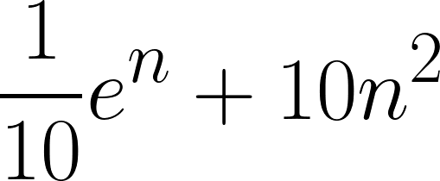
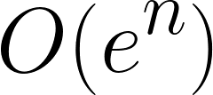
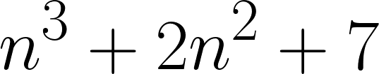
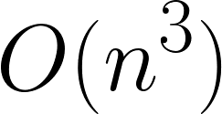
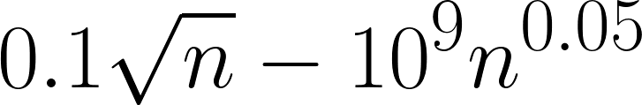
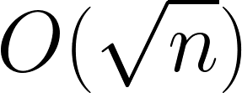
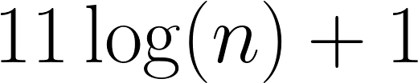
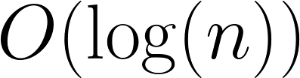
Main idea:
Focus on how the runtime scales with n (the input size).
Some examples…
(Only pay attention to the largest function of n that appears.)
Number of operations | Asymptotic Running Time
We say this algorithm is “asymptotically faster” than the others.

Slide 33
Example Runtime
T(n) = 25n² + 5n + 7 ms
The constant factor of 25 depends on the computing platform..
As n gets large, the lower-order terms don’t really matter
= O(n²)

Slide 34
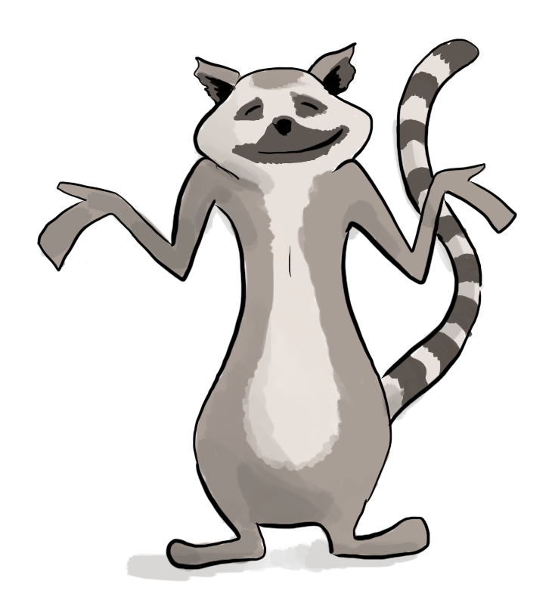
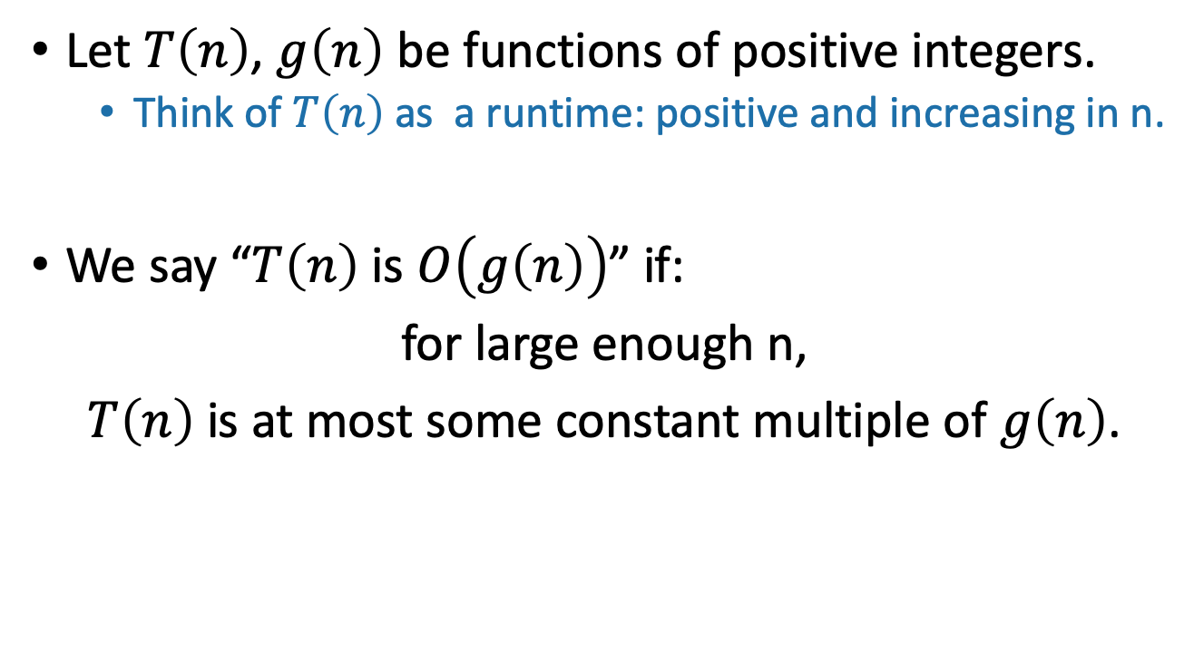
Informal definition for O(…)
pronounced “big-oh of …” or sometimes “oh of …”
Here, “constant” means “some number that doesn’t depend on n.”

Slide 35
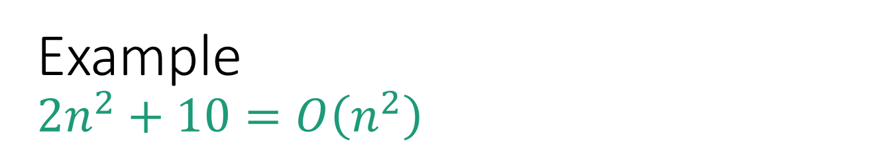
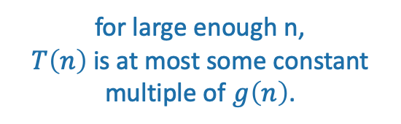
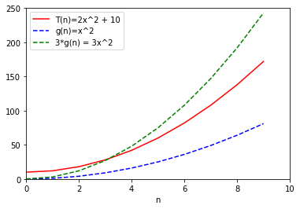
3g(n) = 3n²
T(n) = 2n² + 10
g(n) = n²

Slide 36

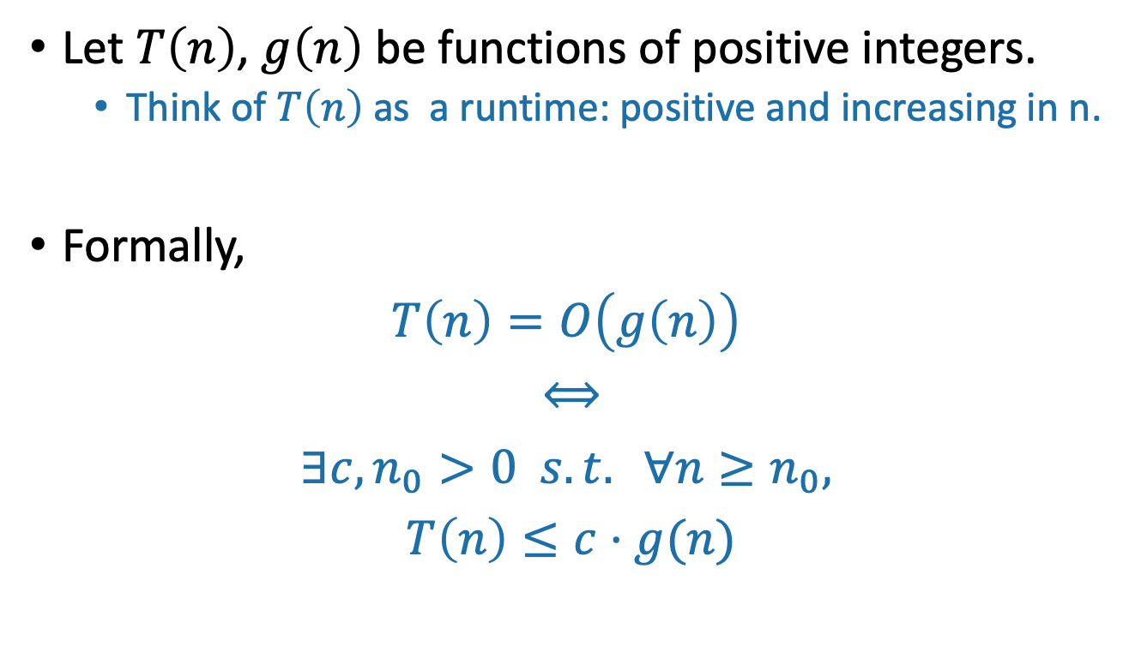
Formal definition of O(…)
“If and only if”
“For all”
“such that”
“There exists”

Slide 37
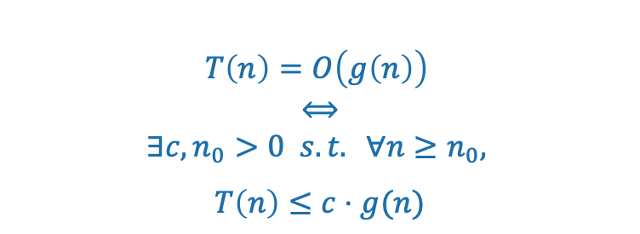
3g(n) = 3n²
T(n) = 2n² + 10
g(n) = n²

Slide 38
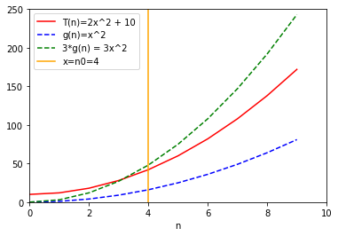
3g(n) = 3n²
(c = 3)
n₀=4
T(n) = 2n² + 10
g(n) = n²

Slide 39

3g(n) = 3n²
(c = 3)
Formally:
Choose c = 3
Choose n₀ = 4
Then:
n₀=4
T(n) = 2n² + 10
g(n) = n²

Slide 40
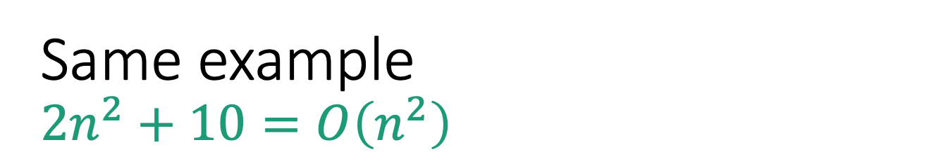
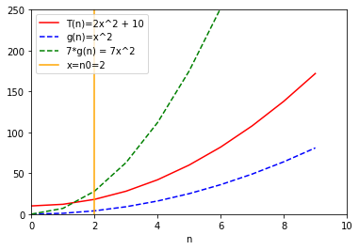

7g(n) = 7n²
Formally:
Choose c = 7
Choose n₀ = 2
Then:
T(n) = 2n² + 10
g(n) = n²
There is no “correct” choice of c and n₀
n₀=2

Slide 41
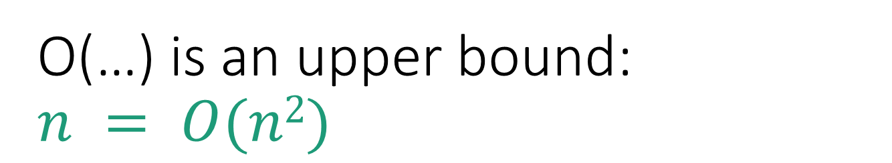
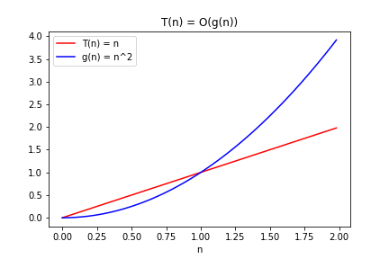
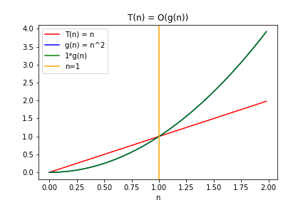

g(n) = n²
Choose c = 1
Choose n₀ = 1
Then
T(n) = n

Slide 42
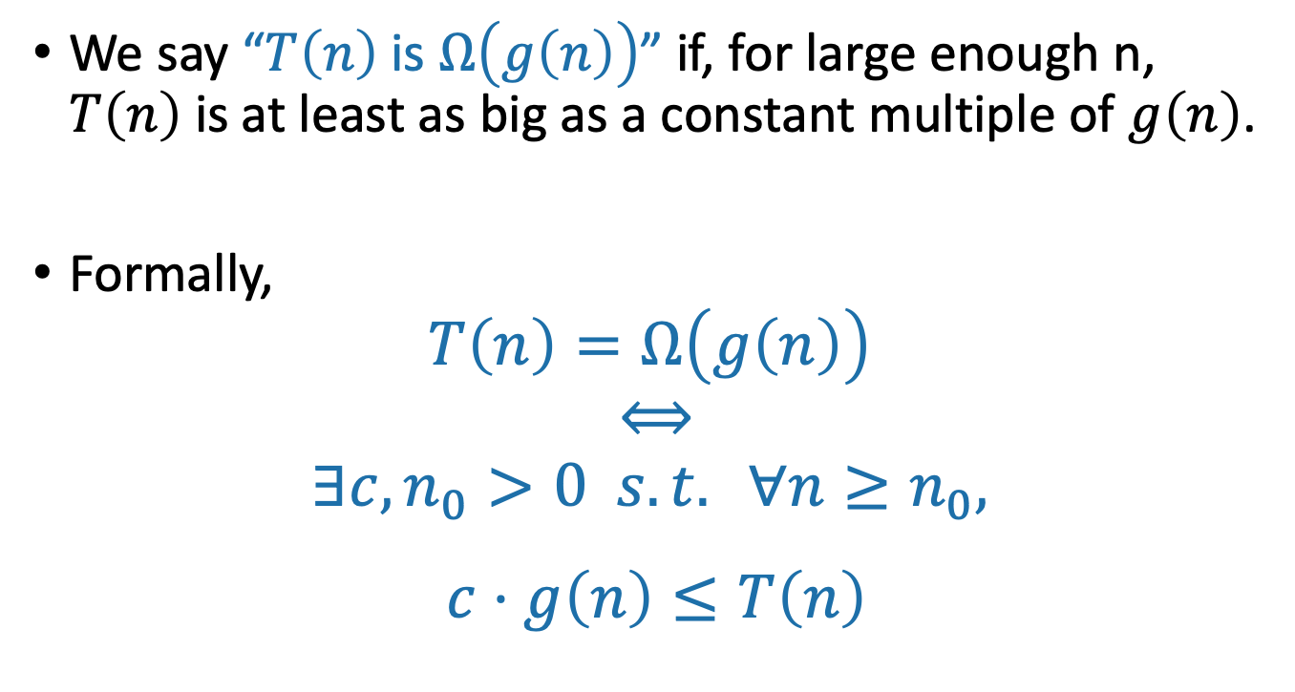
Ω(…) means a lower bound
pronounced “big-omega of …”
Switched these!!

Slide 43
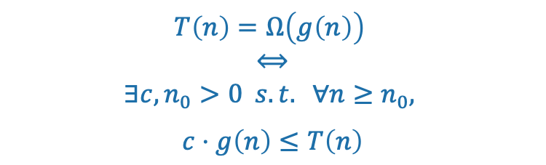
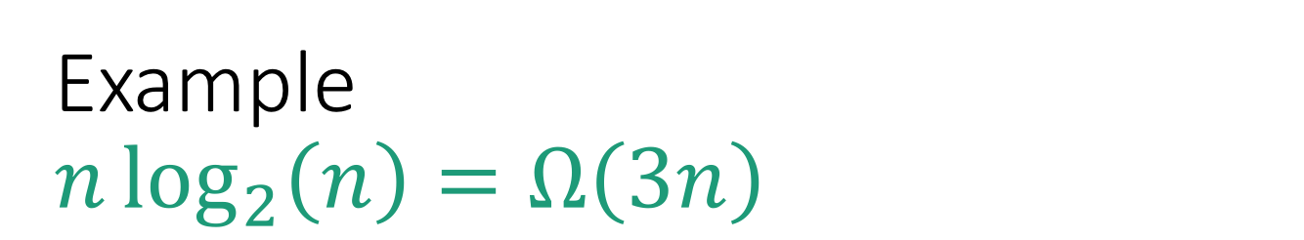
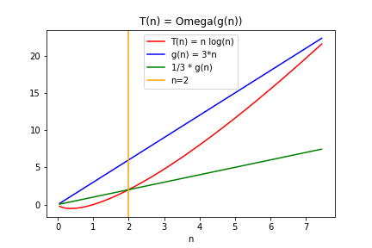
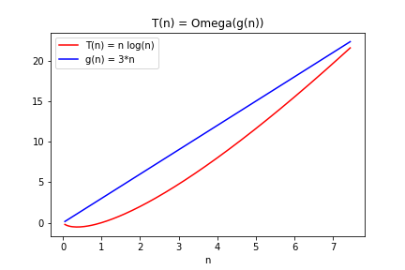
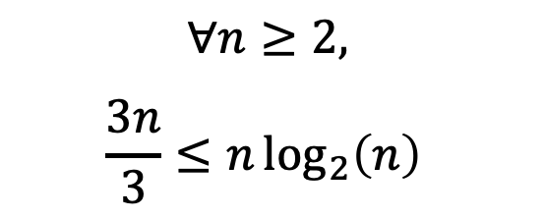
g(n) = 3n
T(n) = nlog(n)
Choose c = 1/3
Choose n₀ = 2
Then
g(n)/3 = n

Slide 44
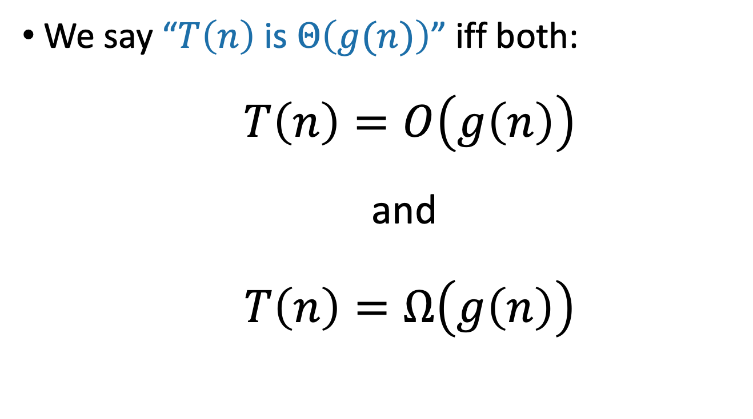
Θ(…) means both!
pronounced “big-theta of …” or sometimes “theta of”

Slide 45
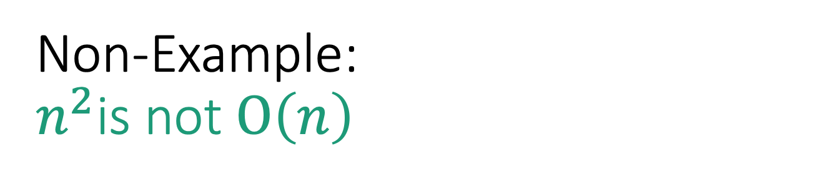
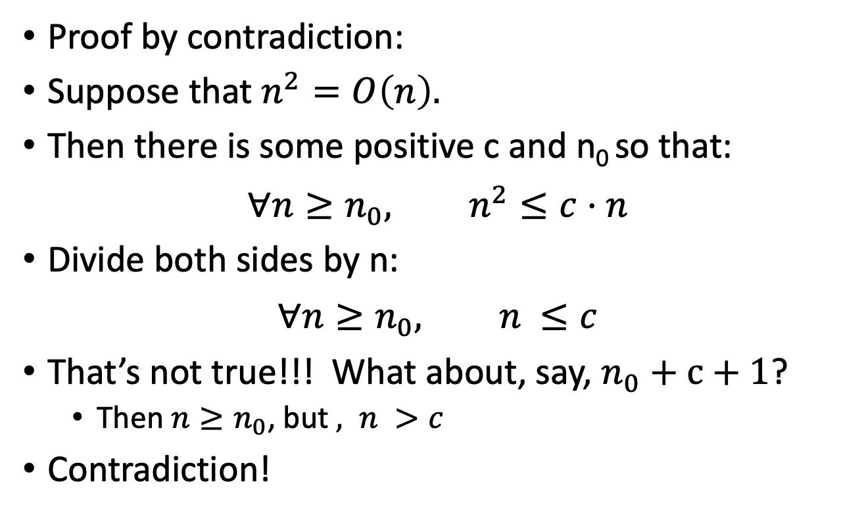

Slide 46
Take-away from examples
To prove T(n) = O(g(n)), you have to come up with c and n₀ so that the definition is satisfied.
To prove T(n) is NOT O(g(n)), one way is proof by contradiction:
Suppose (to get a contradiction) that someone gives you a c and an n₀ so that the definition is satisfied.
Show that this someone must by lying to you by deriving a contradiction.

Slide 47
Practice
f(n) = n and g(n) = n² - n
f(n) = g(n)
f(n) = 2^{n} and g(n) = n²
f(n) = g(n)
f(n) = 8n and g(n) = n log n
f(n) = g(n)

Slide 48
Practice
f(n) = n and g(n) = n² - n
f(n) =O(g(n))
f(n) = 2^{n} and g(n) = n²
f(n) =Ω(g(n))
n grows slower than n²
polynomial functions are slower than exponential functions

Slide 49
Practice
f(n) = 8n and g(n) = n log n
f(n) =O(g(n))
with c = 8, n₀ = 2, 8n ≤ 8n log n
1 ≤ log n, ∀n ≥ 2
f(n) = O(g(n))
lim_{n→∞} 8n / n log n
= lim_{n→∞} 8 / log n
= 0

Slide 50
State order of growth in Θ notation
f(n) = 50
f(n) = n + … + 3 + 2 + 1
f(n) = (g(n))² where g(n) = √n + 5

Slide 51
State order of growth in Θ notation
f(n) = 50
f(n) = Θ(1)
f(n) = n + … + 3 + 2 + 1
f(n) = n(n+1)/2 = (n² + n)/2 = Θ(n²)
f(n) = (g(n))² where g(n) = √n + 5
f(n) = (√n + 5)² = n + 10√n + 25 = Θ(n)

Slide 52
Summary of Definitions
f(n) = O(g(n)) if there exists a c > 0 where after large enough n, f(n) ≤ c * g(n)
Asymptotically f grows as most as much as g
f(n) = Ω(g(n)) if g(n) = O(f(n))
Asymptotically, f grows at least as much as g
f(n) = Θ(g(n)) if f(n) = O(g(n)) and g(n) = O(f(n))
Asymptotically, f and g grow the same

Slide 53
Important Takeaways
If d > c, n^{c} = O(n^{d}) but n^{c} ≠ Ω(n^{d})
Asymptotic notation only cares about the highest growing terms: e.g. n² + n = Ω(n²)
Asymptotic notation does not care about leading constants: e.g. 50n = Θ(n)
Any exponential with base > 1 grows more than any polynomial
The base of the exponential matters: e.g. 3^{n} = O(4^{n}) but 3^{n} ≠ Ω(4^{n})

Slide 54
Any questions?

Slide 55
More Practice! (If time)
Assume that f(n), g(n), and h(n) are all non-negative functions of integers.
If f(n) = O(g(n)), then f(n) * h(n) = O(g(n) * h(n))
f(n) = Ω(g(n)) if g(n) = O(f(n))

Slide 56
More Practice! (if time)

